Slide 1
CHAPTER -5
CONTINUITY
AND DIFFERENTIABILITY
MODULE : 4/4 e -content

Slide 2
CONCEPTS
Derivative of functions in parametric form
Second order derivative

Slide 3
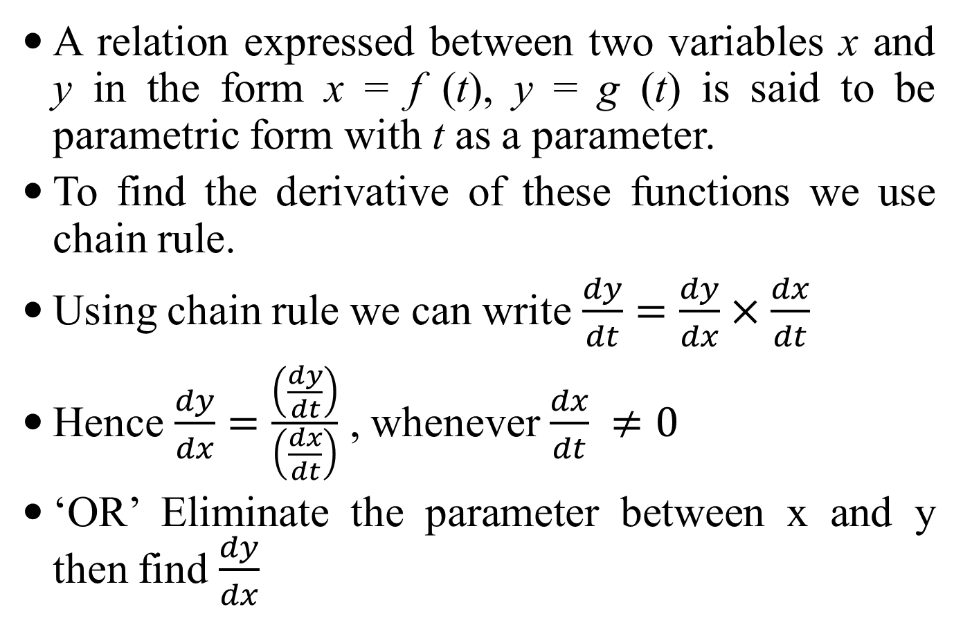
DERIVATIVES OF FUNCTIONS IN PARAMETRIC FORMS
A relation expressed between two variables x and y in the form x = f (t), y = g (t) is said to be parametric form with t as a parameter.
To find the derivative of these functions we use chain rule.
Using chain rule we can write $\frac{dy}{dt}=\frac{dy}{dx}×\frac{dx}{dt}$
Hence $\frac{dy}{dx}=\frac{\left(\frac{dy}{dt}\right)}{\left(\frac{dx}{dt}\right)}$ , whenever $\frac{dx}{dt} ≠0$
‘OR’ Eliminate the parameter between x and y then find $\frac{dy}{dx}$

Slide 4
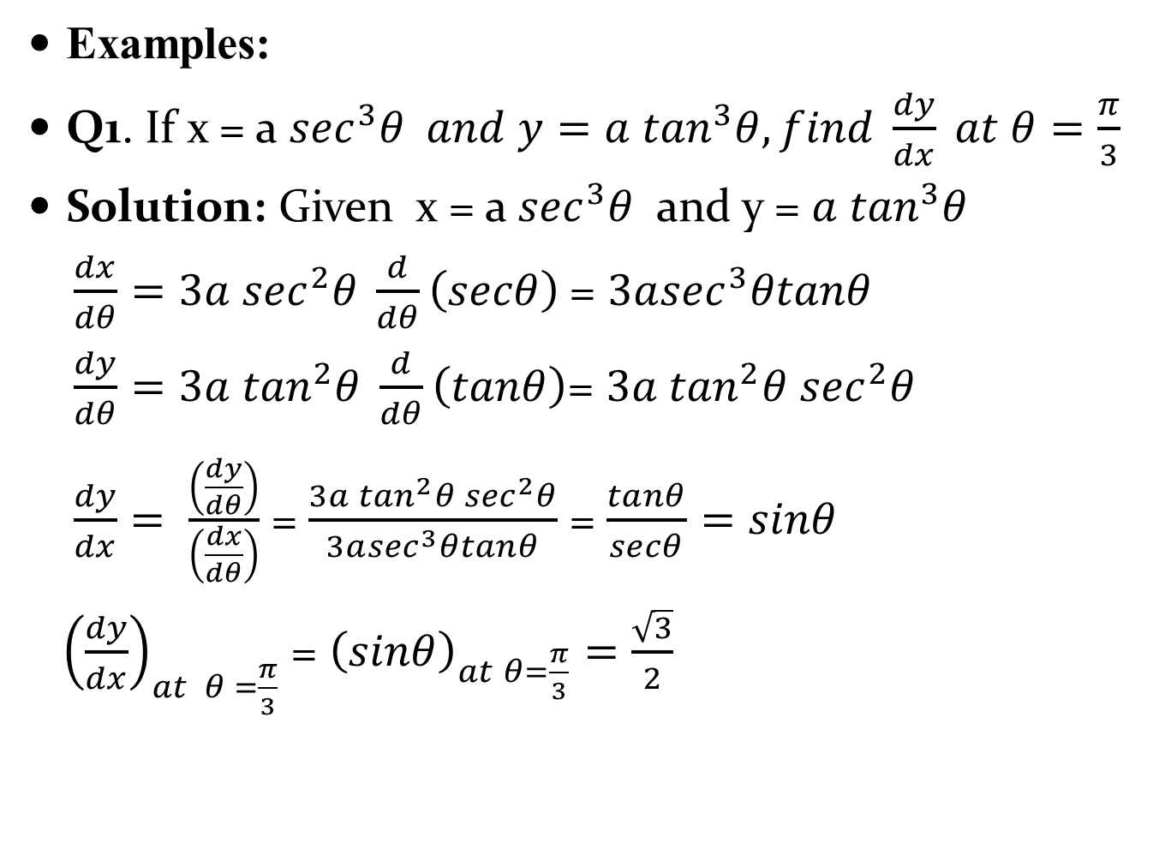
Examples:
Q1. If x = a $\sec^{3}θ and y=a \tan^{3}θ, find \frac{dy}{dx} at θ=\frac{π}{3}$
Solution: Given x = a $\sec^{3}θ$ and y = $a \tan^{3}θ$
$\frac{dx}{dθ}=3a \sec^{2}θ \frac{d}{dθ}\left(secθ\right)$= $3a\sec^{3}θtanθ$
$\frac{dy}{dθ}=3a \tan^{2}θ \frac{d}{dθ}\left(tanθ\right)$= $3a \tan^{2}θ \sec^{2}θ$
$\frac{dy}{dx}= \frac{\left(\frac{dy}{dθ}\right)}{\left(\frac{dx}{dθ}\right)}$ = $\frac{3a \tan^{2}θ \sec^{2}θ}{3a\sec^{3}θtanθ}$ = $\frac{tanθ}{secθ}=sinθ$
${\left(\frac{dy}{dx}\right)}_{at θ =\frac{π}{3}}$ = ${\left(sinθ\right)}_{at θ=\frac{π}{3}}=\frac{\sqrt{3}}{2}$

Slide 5
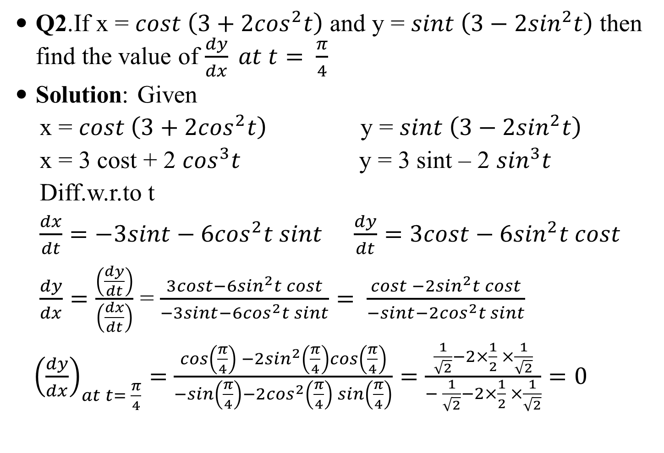
Q2.If x = $cost \left(3+2\cos^{2}t\right)$ and y = $sint \left(3−2\sin^{2}t\right)$ then find the value of $\frac{dy}{dx} at t= \frac{π}{4}$
Solution: Given
x = $cost \left(3+2\cos^{2}t\right)$ y = $sint \left(3−2\sin^{2}t\right)$
x = 3 cost + 2 $\cos^{3}t$ y = 3 sint – 2 $\sin^{3}t$
Diff.w.r.to t
$\frac{dx}{dt}=−3sint−6\cos^{2}t sint$ $\frac{dy}{dt}=3cost−6\sin^{2}t cost$
$\frac{dy}{dx}=\frac{\left(\frac{dy}{dt}\right)}{\left(\frac{dx}{dt}\right)}$ = $\frac{3cost−6\sin^{2}t cost}{−3sint−6\cos^{2}t sint}= \frac{cost −2\sin^{2}t cost}{−sint−2\cos^{2}t sint}$
${\left(\frac{dy}{dx}\right)}_{at t= \frac{π}{4}}=$ $\frac{cos\left(\frac{π}{4}\right) −2\sin^{2}\left(\frac{π}{4}\right)cos\left(\frac{π}{4}\right)}{−sin\left(\frac{π}{4}\right)−2\cos^{2}\left(\frac{π}{4}\right) sin\left(\frac{π}{4}\right)}=\frac{\frac{1}{\sqrt{2}}−2×\frac{1}{2} ×\frac{1}{\sqrt{2}}}{− \frac{1}{\sqrt{2}}−2×\frac{1}{2} ×\frac{1}{\sqrt{2}}}=0$

Slide 6
DIFFERENTIATION OF A FUNCTION W.R.TO ANOTHER FUNCTION
Let u = f(x) and v = g(x) be two functions of x , then to find the derivative of f(x) w.r.to g(x) i.e. to find the derivative of u w.r.to v we use the formula
$\frac{du}{dv}=\frac{\left(\frac{du}{dx}\right)}{\left(\frac{dv}{dx}\right)}$
Examples:
Q1. Differentiate$\tan^{−1}\left(\frac{x}{\sqrt{1−x^{2}}}\right)$ w.r.to
$\sin^{−1}\left(2x\sqrt{1−x^{2}}\right)$

Slide 7
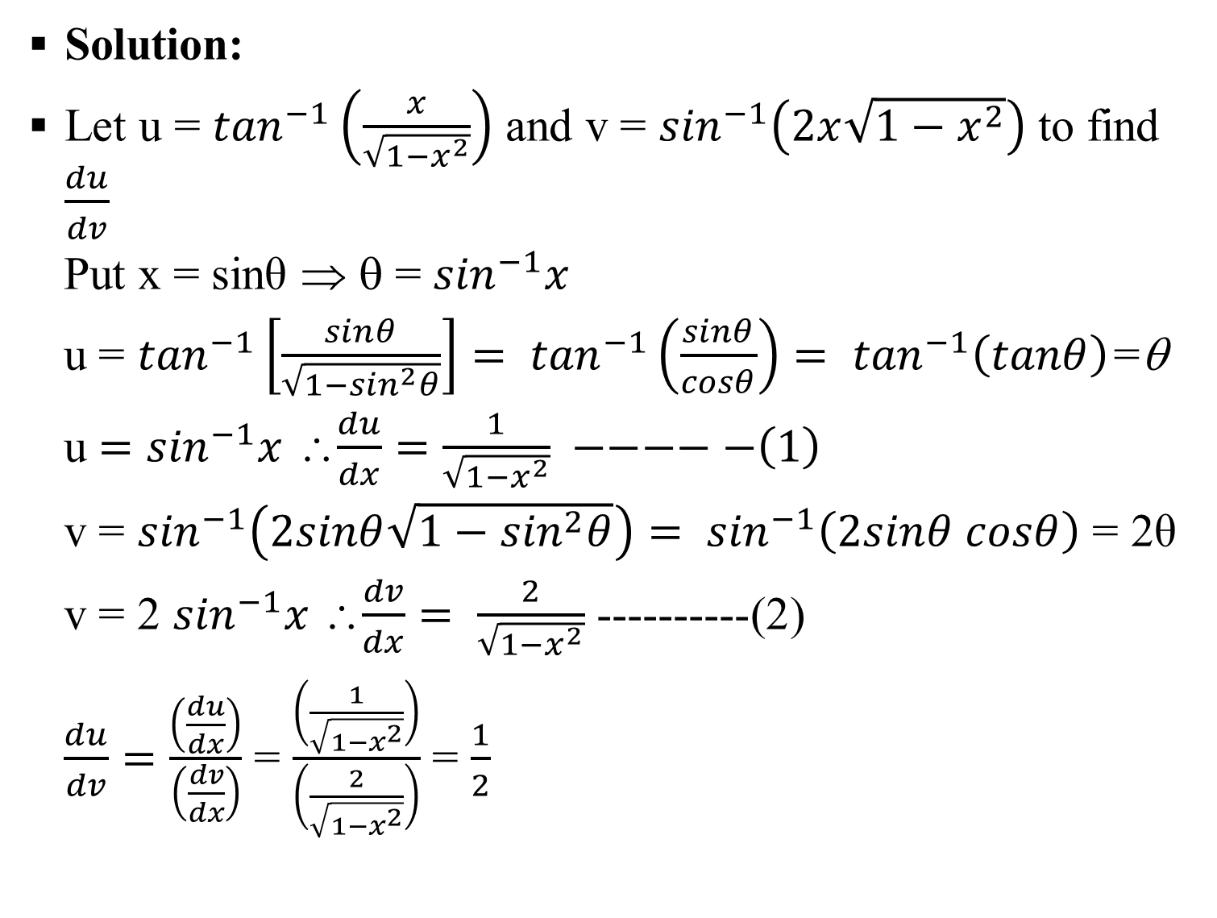
Solution:
Let u = $\tan^{−1}\left(\frac{x}{\sqrt{1−x^{2}}}\right)$ and v = $\sin^{−1}\left(2x\sqrt{1−x^{2}}\right)$ to find $\frac{du}{dv}$
Put x = sinθ ⇒ θ = $\sin^{−1}x$
u = $\tan^{−1}\left[\frac{sinθ}{\sqrt{1−\sin^{2}θ}}\right]= \tan^{−1}\left(\frac{sinθ}{cosθ}\right)= \tan^{−1}\left(tanθ\right)$=θ
u $=\sin^{−1}x$ ∴$\frac{du}{dx}=\frac{1}{\sqrt{1−x^{2}}} −−−−−\left(1\right)$
v = $\sin^{−1}\left(2sinθ\sqrt{1−\sin^{2}θ}\right)= \sin^{−1}\left(2sinθ cosθ\right)$ = 2θ
v = 2 $\sin^{−1}x$ ∴$\frac{dv}{dx}= \frac{2}{\sqrt{1−x^{2}}}$ ----------(2)
$\frac{du}{dv}=\frac{\left(\frac{du}{dx}\right)}{\left(\frac{dv}{dx}\right)}$ = $\frac{\left(\frac{1}{\sqrt{1−x^{2}}}\right)}{\left(\frac{2}{\sqrt{1−x^{2}}}\right)}$ = $\frac{1}{2}$

Slide 8
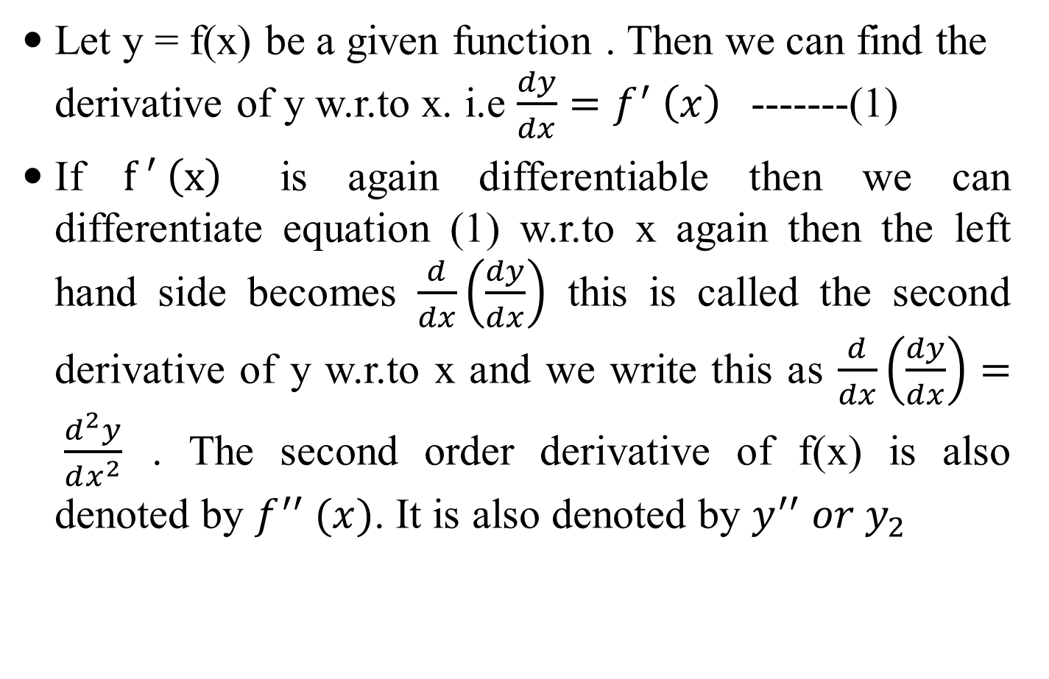
SECOND ORDER DERIVATIVE
Let y = f(x) be a given function . Then we can find the derivative of y w.r.to x. i.e $\frac{dy}{dx}=f^{′} \left(x\right)$ -------(1)
If $f ′ \left(x\right)$ is again differentiable then we can differentiate equation (1) w.r.to x again then the left hand side becomes $\frac{d}{dx}\left(\frac{dy}{dx}\right)$ this is called the second derivative of y w.r.to x and we write this as $\frac{d}{dx}\left(\frac{dy}{dx}\right)= \frac{d^{2}y}{dx^{2}}$ . The second order derivative of f(x) is also denoted by $f^{′′} (x)$. It is also denoted by $y^{′′} or y_{2}$

Slide 9
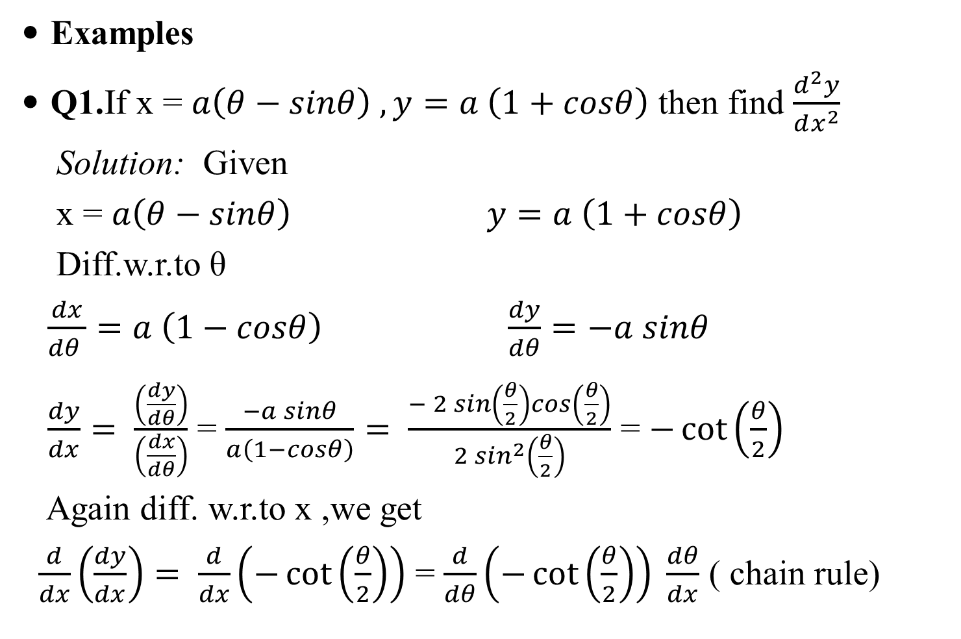
Examples
Q1.If x = $a\left(θ−sinθ\right) , y=a \left(1+cosθ\right)$ then find $\frac{d^{2}y}{dx^{2}}$
Solution: Given
x = $a\left(θ−sinθ\right) y=a \left(1+cosθ\right)$
Diff.w.r.to θ
$\frac{dx}{dθ }=a \left(1−cosθ\right)$ $\frac{dy}{dθ}=−a sinθ$
$\frac{dy}{dx}= \frac{\left(\frac{dy}{dθ}\right)}{\left(\frac{dx}{dθ}\right)}$ = $\frac{−a sinθ}{a\left(1−cosθ\right)}= \frac{− 2 sin\left(\frac{θ}{2}\right)cos\left(\frac{θ}{2}\right)}{2 \sin^{2}\left(\frac{θ}{2}\right)}$ = $−\cot\left(\frac{θ}{2}\right)$
Again diff. w.r.to x ,we get
$\frac{d}{dx}\left(\frac{dy}{dx}\right)= \frac{d}{dx}\left(−\cot\left(\frac{θ}{2}\right)\right)$ = $\frac{d}{dθ}\left(−\cot\left(\frac{θ}{2}\right)\right) \frac{dθ}{dx}$ ( chain rule)

Slide 10
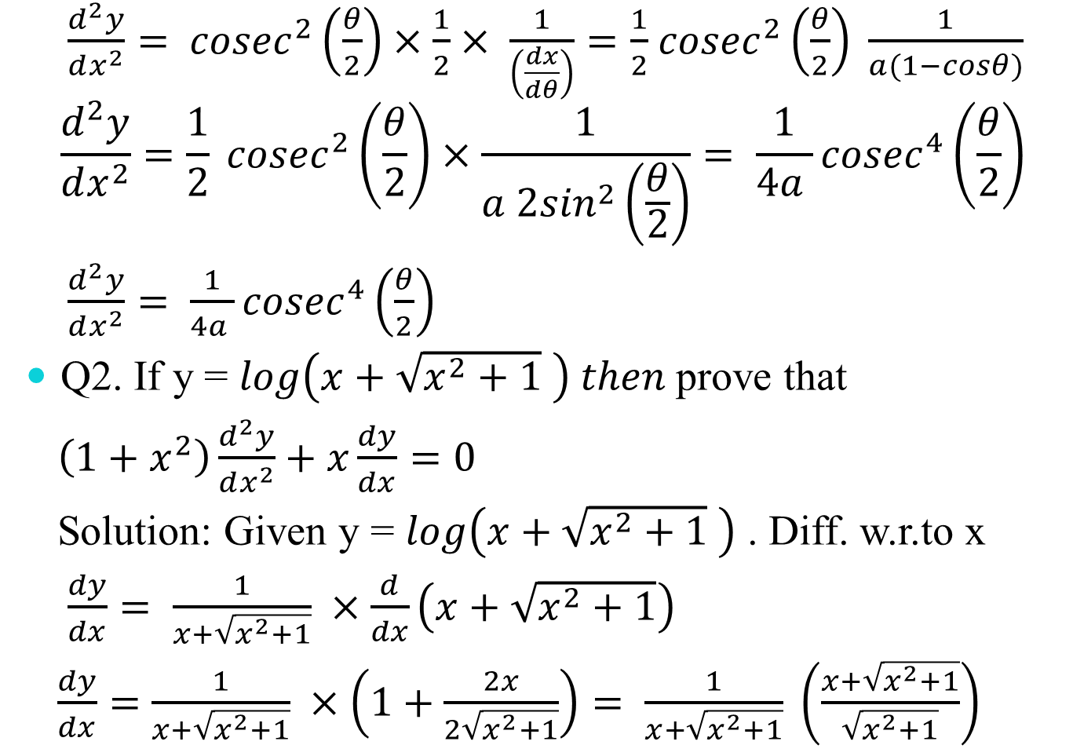
$\frac{d^{2}y}{dx^{2}}=$ ${cosec}^{2}\left(\frac{θ}{2}\right)×\frac{1}{2}× \frac{1}{\left(\frac{dx}{dθ}\right)}=\frac{1}{2}$ ${cosec}^{2}\left(\frac{θ}{2}\right) \frac{1}{a(1−cosθ)}$
$$\frac{d^{2}y}{dx^{2}}=\frac{1}{2} {cosec}^{2}\left(\frac{θ}{2}\right)×\frac{1}{a 2\sin^{2}\left(\frac{θ}{2}\right)}= \frac{1}{4a }{cosec}^{4}\left(\frac{θ}{2}\right)$$
$\frac{d^{2}y}{dx^{2}}= \frac{1}{4a }{cosec}^{4}\left(\frac{θ}{2}\right)$
Q2. If y = $log\left(x+\sqrt{x^{2}+1} \right) then$prove that
$\left(1+x^{2}\right)\frac{d^{2}y}{dx^{2}}+x\frac{dy}{dx}=0$
Solution: Given y = $log\left(x+\sqrt{x^{2}+1} \right)$ . Diff. w.r.to x
$\frac{dy}{dx}= \frac{1}{x+\sqrt{x^{2}+1}} ×\frac{d}{dx}\left(x+\sqrt{x^{2}+1}\right)$
$\frac{dy}{dx}=$ $\frac{1}{x+\sqrt{x^{2}+1}} ×\left(1+\frac{2x}{2\sqrt{x^{2}+1}}\right)= \frac{1}{x+\sqrt{x^{2}+1}} \left(\frac{x+\sqrt{x^{2}+1}}{\sqrt{x^{2}+1}}\right)$

Slide 11
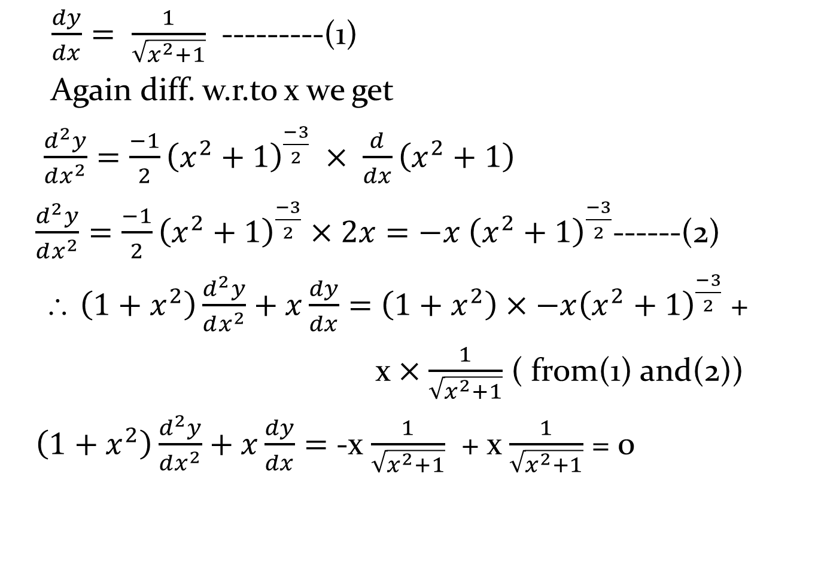
$\frac{dy}{dx}= \frac{1}{\sqrt{x^{2}+1}}$ ---------(1)
Again diff. w.r.to x we get
$\frac{d^{2}y}{dx^{2}}=\frac{−1}{2}{\left(x^{2}+1\right)}^{\frac{−3}{2}} × \frac{d}{dx}\left(x^{2}+1\right)$
$\frac{d^{2}y}{dx^{2}}=\frac{−1}{2}{\left(x^{2}+1\right)}^{\frac{−3}{2}}×2x=−x {\left(x^{2}+1\right)}^{\frac{−3}{2}}$------(2)
∴ $\left(1+x^{2}\right)\frac{d^{2}y}{dx^{2}}+x\frac{dy}{dx}=$ $\left(1+x^{2}\right)×−x{\left(x^{2}+1\right)}^{\frac{−3}{2}}$ +
x $×\frac{1}{\sqrt{x^{2}+1}}$ ( from(1) and(2))
$\left(1+x^{2}\right)\frac{d^{2}y}{dx^{2}}+x\frac{dy}{dx}=$ -x $\frac{1}{\sqrt{x^{2}+1}}$ + x $\frac{1}{\sqrt{x^{2}+1}}$ = 0

Slide 12
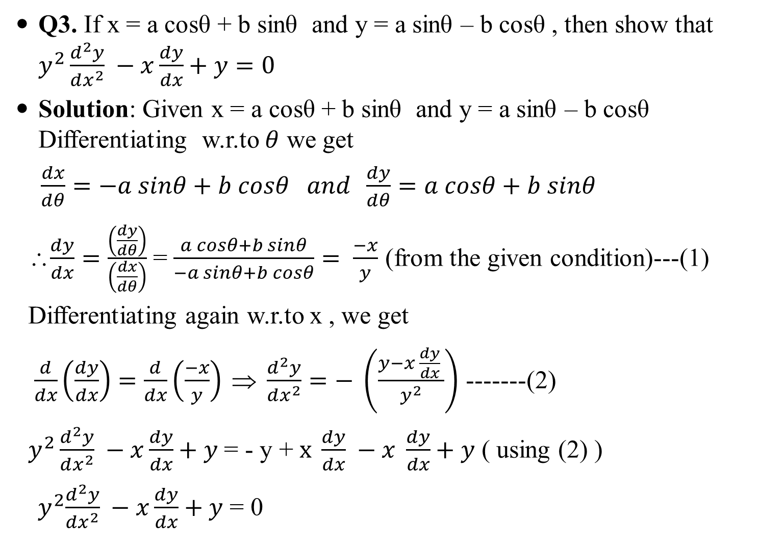
Q3. If x = a cosθ + b sinθ and y = a sinθ – b cosθ , then show that $y^{2}\frac{d^{2}y}{dx^{2}} −x\frac{dy}{dx}+y=0$
Solution: Given x = a cosθ + b sinθ and y = a sinθ – b cosθ Differentiating w.r.to $θ$ we get
$\frac{dx}{dθ}=−a sinθ+b cosθ and \frac{dy}{dθ}=a cosθ+b sinθ$
∴$\frac{dy}{dx}=\frac{\left(\frac{dy}{dθ}\right)}{\left(\frac{dx}{dθ}\right)}$ = $\frac{a cosθ+b sinθ}{−a sinθ+b cosθ}= \frac{−x}{y}$ (from the given condition)---(1)
Differentiating again w.r.to x , we get
$\frac{d}{dx}\left(\frac{dy}{dx}\right)=\frac{d}{dx}\left(\frac{−x}{y}\right) ⇒ \frac{d^{2}y}{dx^{2}}=− \left(\frac{y−x \frac{dy}{dx} }{y^{2}}\right)$ -------(2)
$y^{2}\frac{d^{2}y}{dx^{2}} −x\frac{dy}{dx}+y$ = - y + $x \frac{dy}{dx} −x \frac{dy}{dx}+y$ ( using (2) )
${ y}^{2}\frac{d^{2}y}{dx^{2}} −x\frac{dy}{dx}+y$ = 0

Slide 13
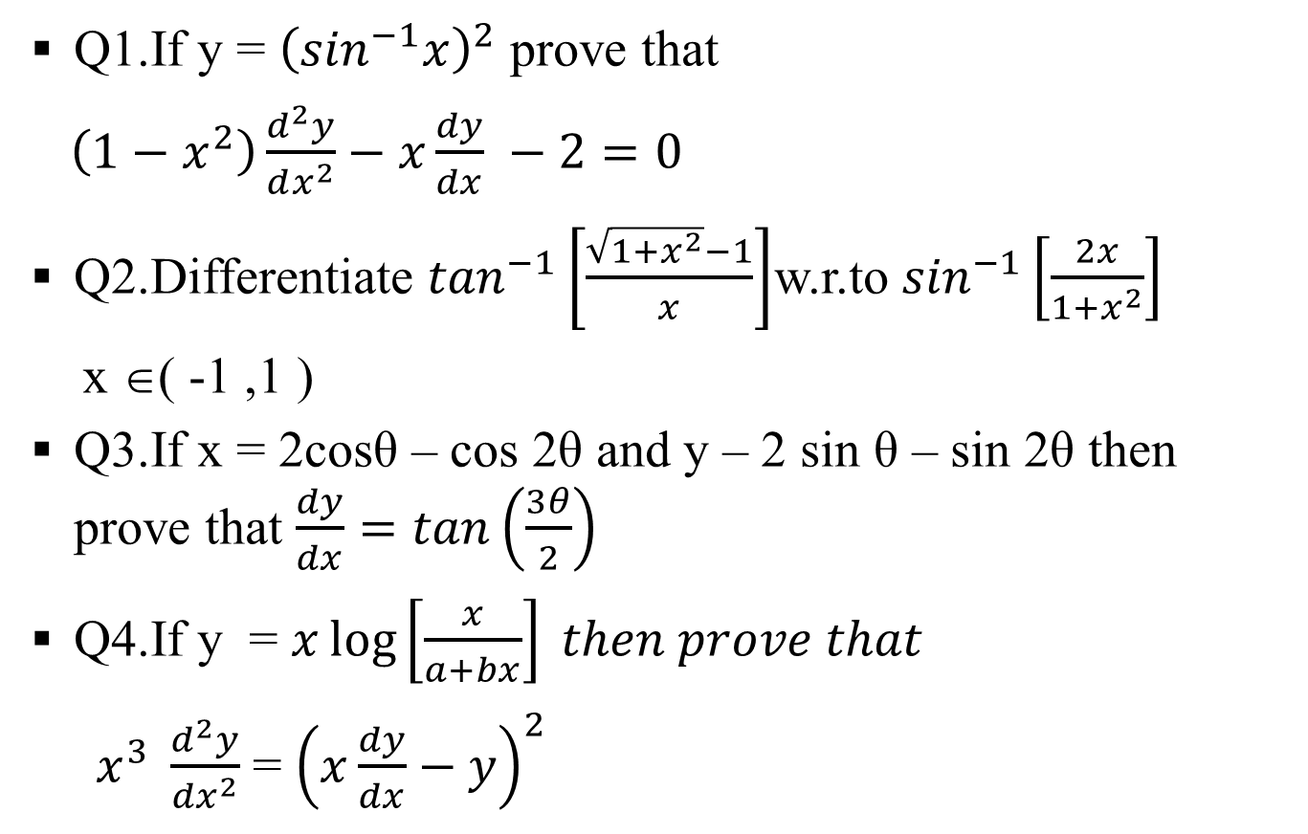
QUESTIONS FOR PRACTICE
Q1.If y = ${\left(\sin^{−1}x\right)}^{2}$ prove that
$\left(1−x^{2}\right)\frac{d^{2}y}{dx^{2}}−x\frac{dy}{dx} −2=0$
Q2.Differentiate $\tan^{−1}\left[\frac{\sqrt{1+x^{2}}−1}{x}\right]$w.r.to $\sin^{−1}\left[\frac{2x}{1+x^{2}}\right]$
x ∈( -1 ,1 )
Q3.If x = 2cosθ – cos 2θ and y – 2 sin θ – sin 2θ then prove that $\frac{dy}{dx}=tan\left(\frac{3θ}{2}\right)$
Q4.If y = $x\log\left[\frac{x}{a+bx}\right] then prove that$
$x^{3} \frac{d^{2}y}{{dx}^{2}}$ = ${\left(x\frac{dy}{dx}−y\right)}^{2}$

